Slide 1
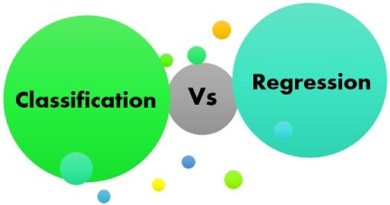
Madhuri gupta da/ds batch 28

Slide 2

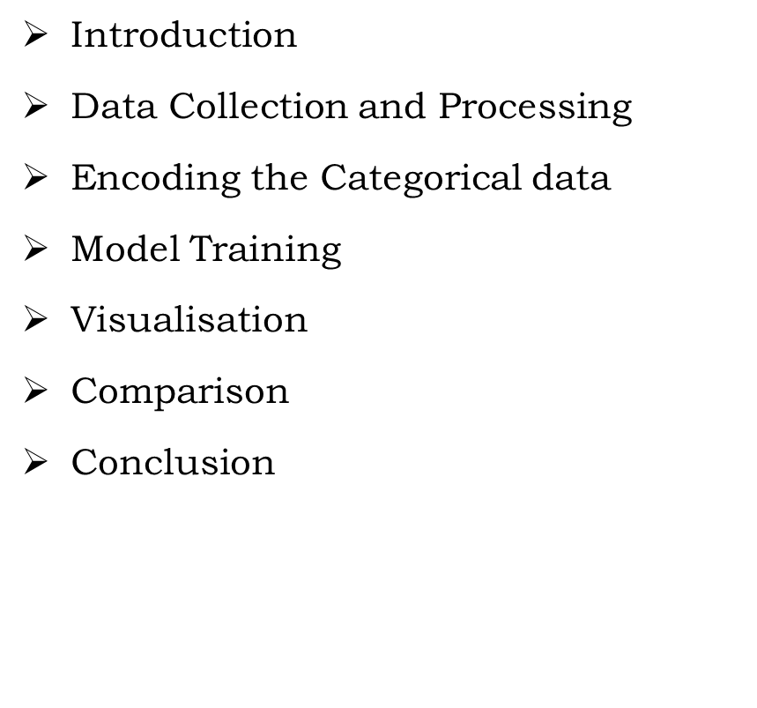
OBJECTIVE
Introduction
Introduction
Data Collection and Processing
Encoding the Categorical data
Model Training
Visualisation
Comparison
Conclusion

Slide 3
Introduction
Machine learning (ML) is a transformative technology that enables systems to learn from data, identify patterns, and make decisions with minimal human intervention. Among the most fundamental tasks in ML are classification and regression—two techniques that serve as the foundation for many real-world applications.
Classification refers to the process of categorizing data into predefined labels or classes. It is widely used in fields like image recognition, spam detection, and medical diagnosis. In classification, the model predicts a discrete output, such as determining whether an email is spam or not.
Regression, on the other hand, deals with predicting continuous values. It is instrumental in areas like stock price forecasting, sales prediction, and weather modeling. In regression, the goal is to predict a real number, such as the price of a house or future sales based on historical data.
Both classification and regression techniques use a variety of algorithms, including decision trees, support vector machines, and neural networks. Understanding the differences and applications of these two techniques is crucial for anyone looking to develop machine learning models or interpret their outputs effectively.

Slide 4

MACHINE LEARNING
Machine learning (ML) is a branch of artificial intelligence (AI) and computer science that focuses on the using data and algorithms to enable AI to imitate the way that humans learn, gradually improving its accuracy.

Slide 5

KEY POINT
Introduction to Machine Learning
Types of Machine Learning
Key Concepts
Classification vs Regression
Popular Algorithms
Applications of Machine Learning
Challenges in Machine Learning
Future of Machine Learning

Slide 6
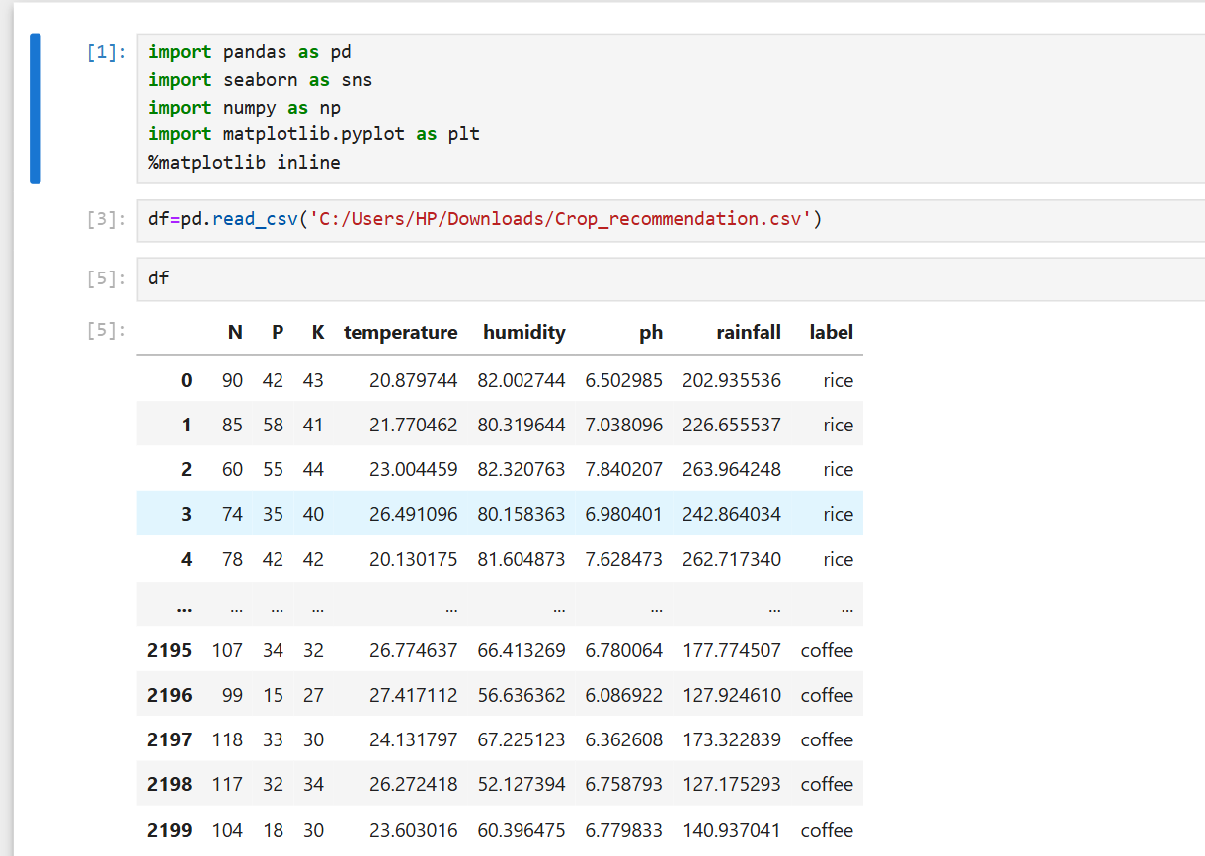
DATA COLLECTING AND PROCESSING

Slide 7
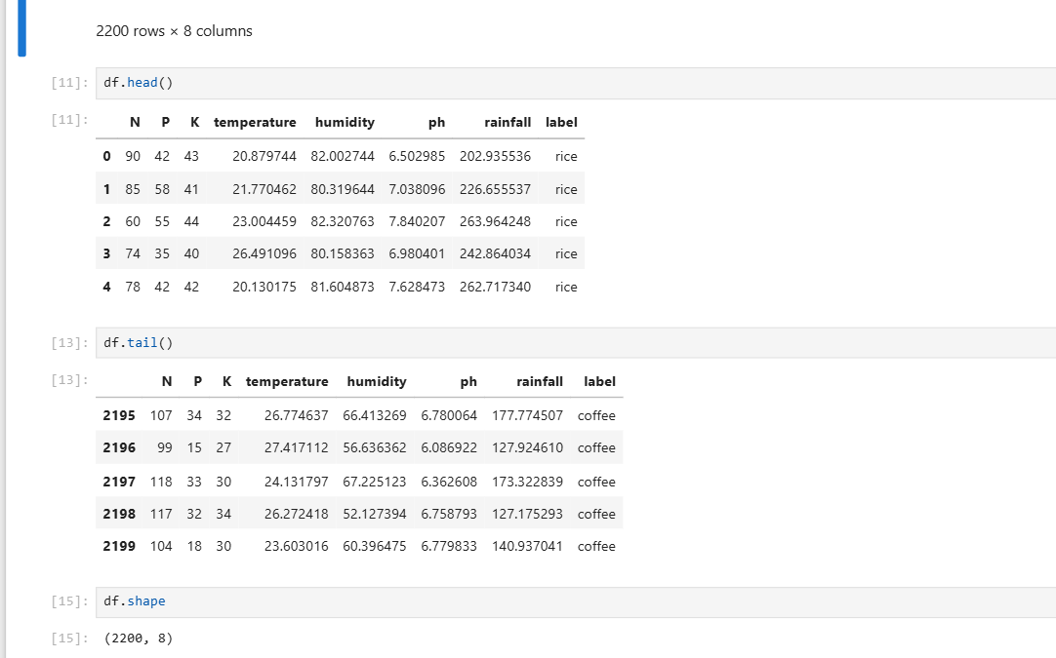
Head AND TAIL

Slide 8
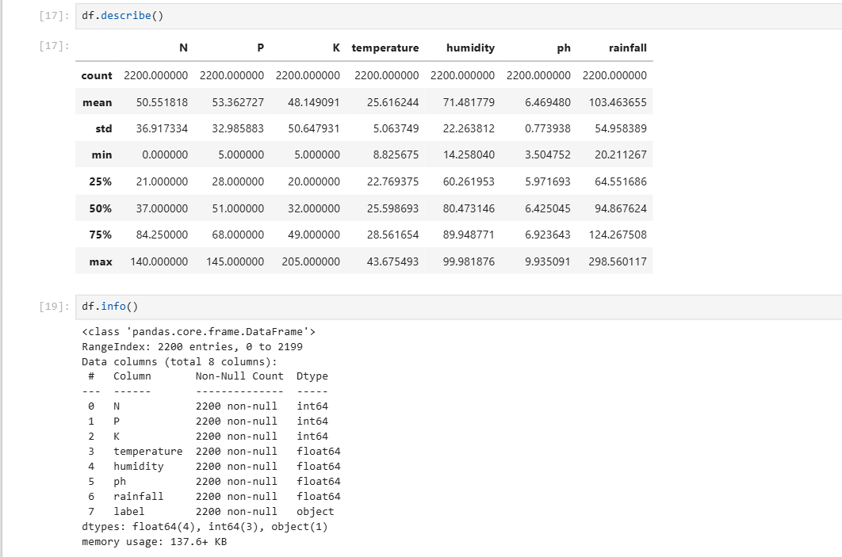

Slide 9
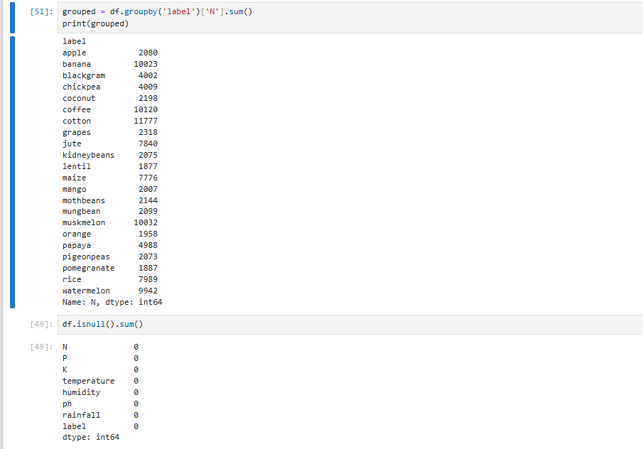
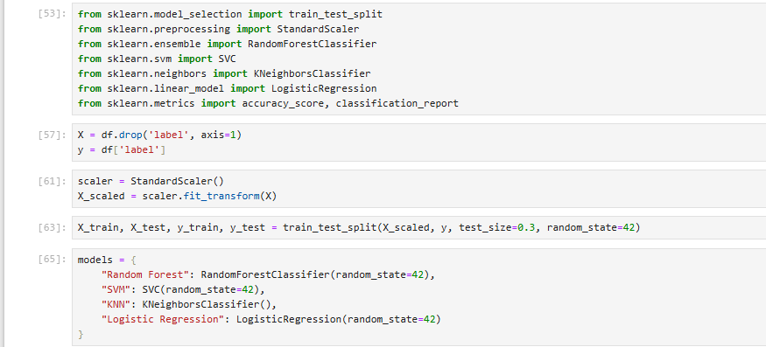

Slide 10
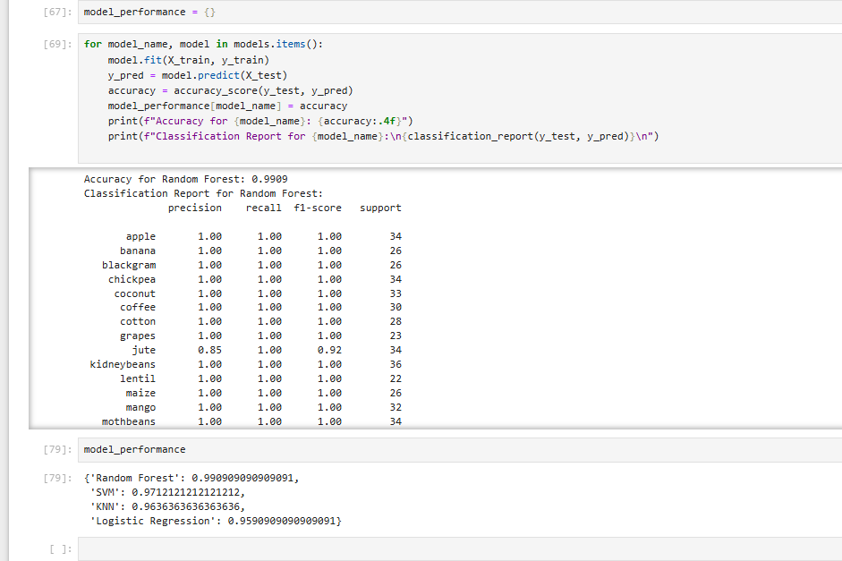

Slide 11
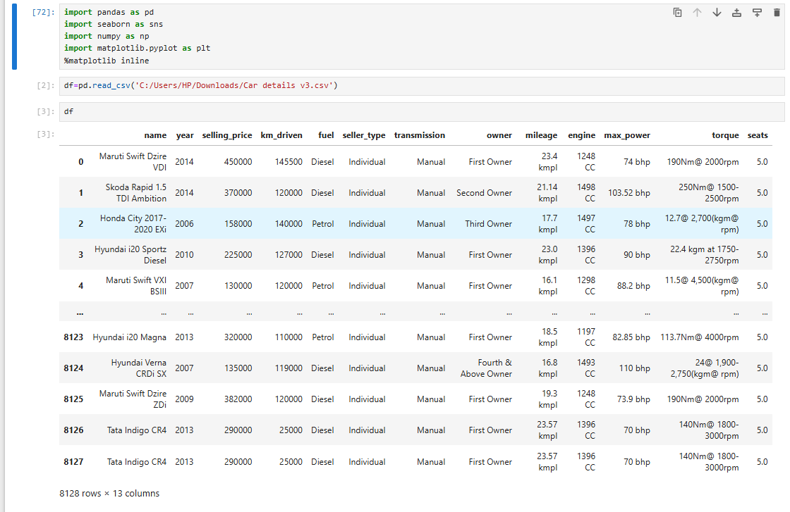
IMPORTING AND READING CSV

Slide 12
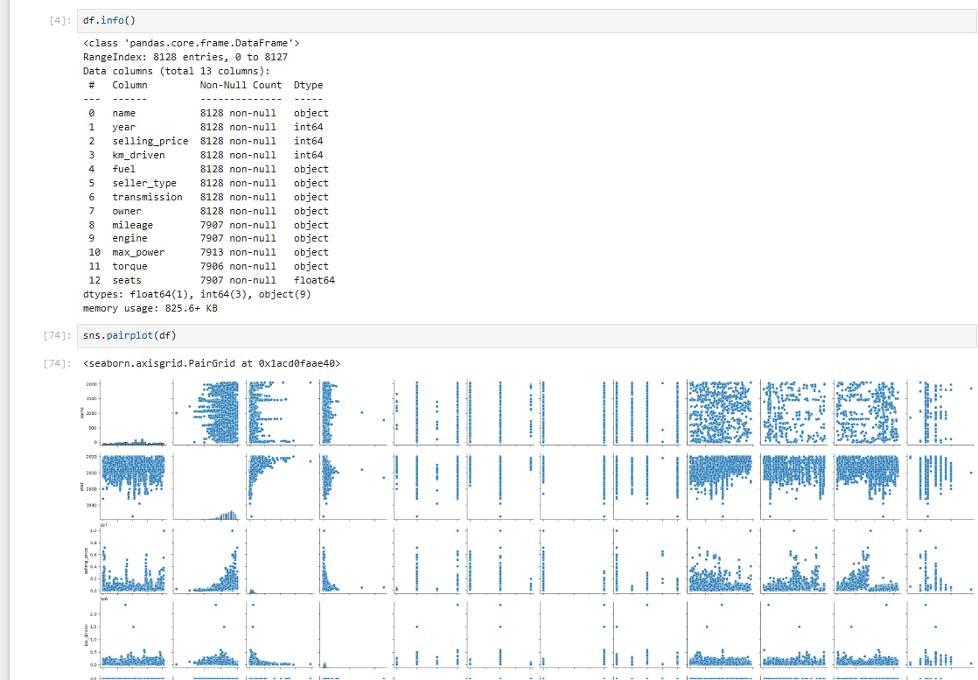
PAIR PLOT

Slide 13
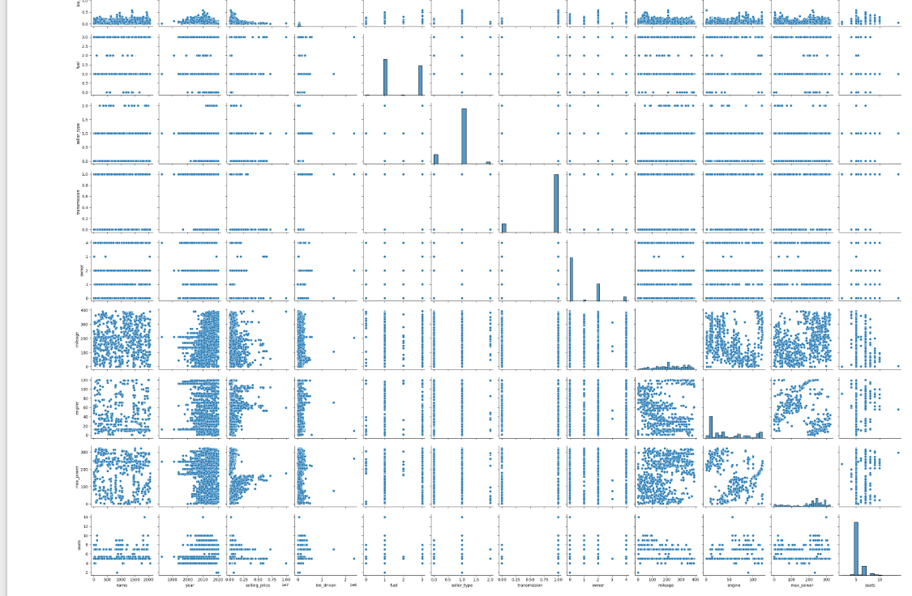

Slide 14
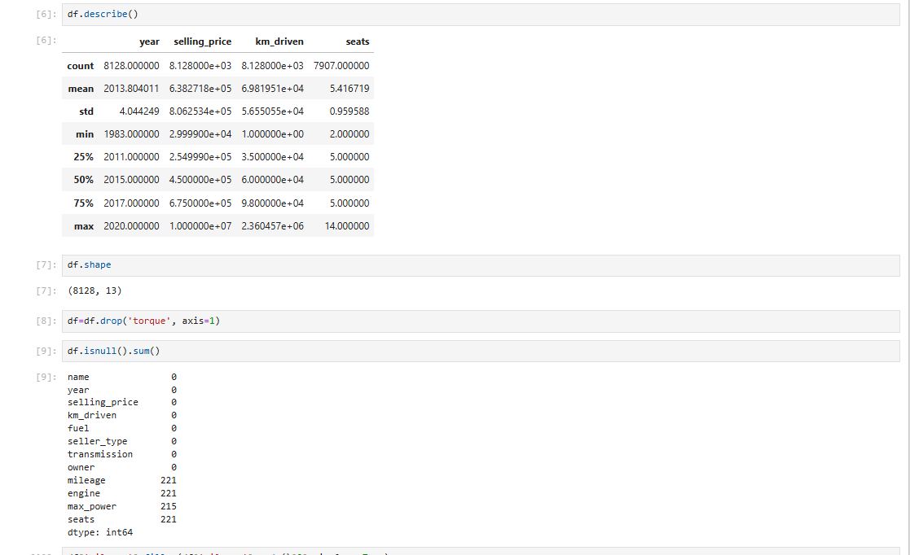
FINDING NULL VALUES

Slide 15
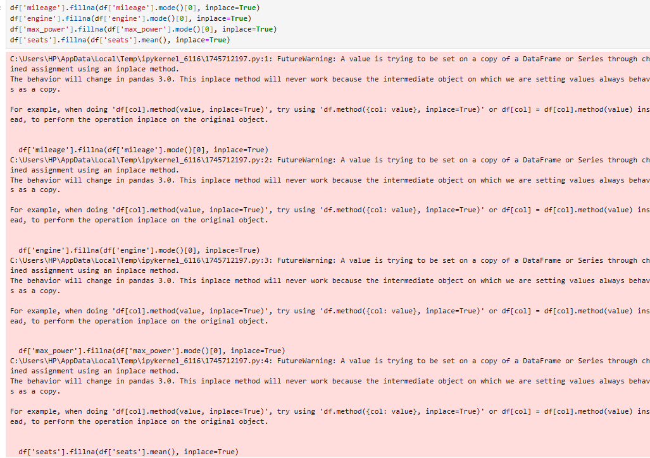

Slide 16
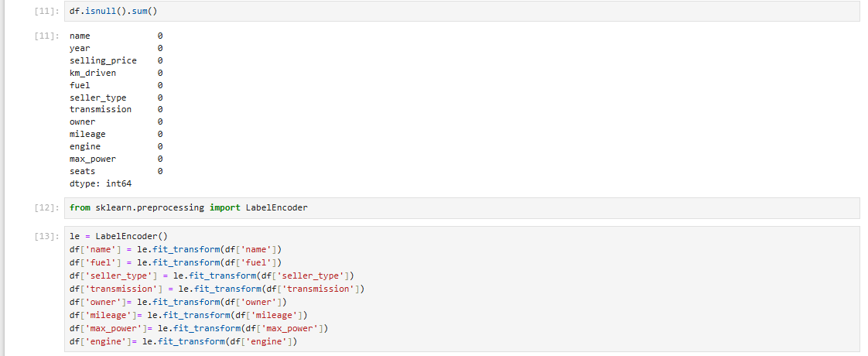
OUTLINER DETECTION AND REMOVAL

Slide 17
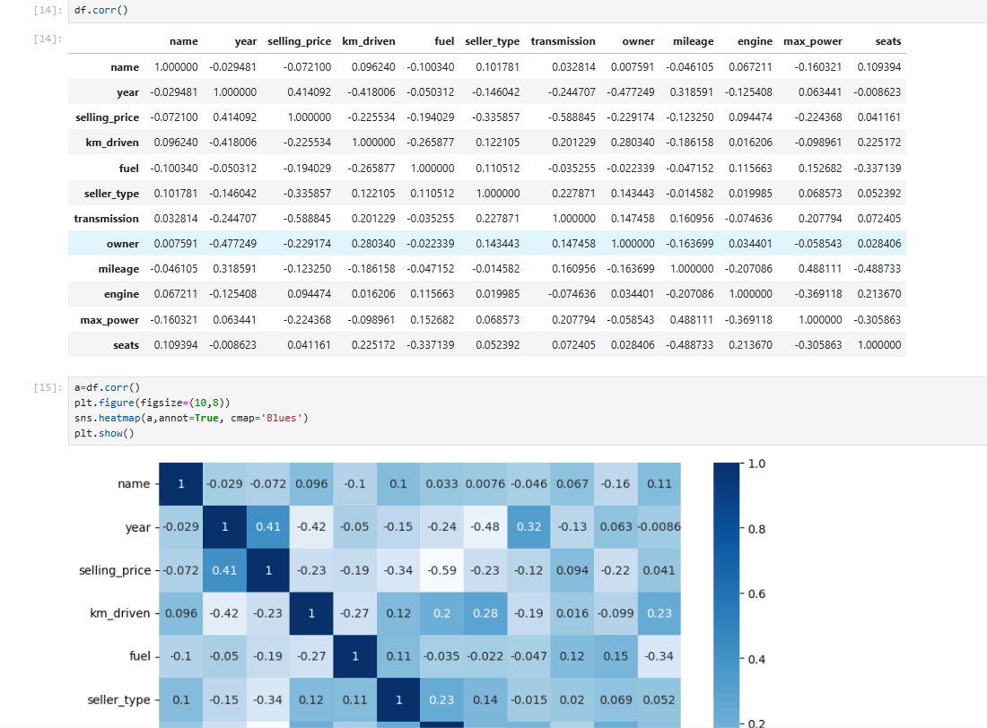
HEAT MAP

Slide 18
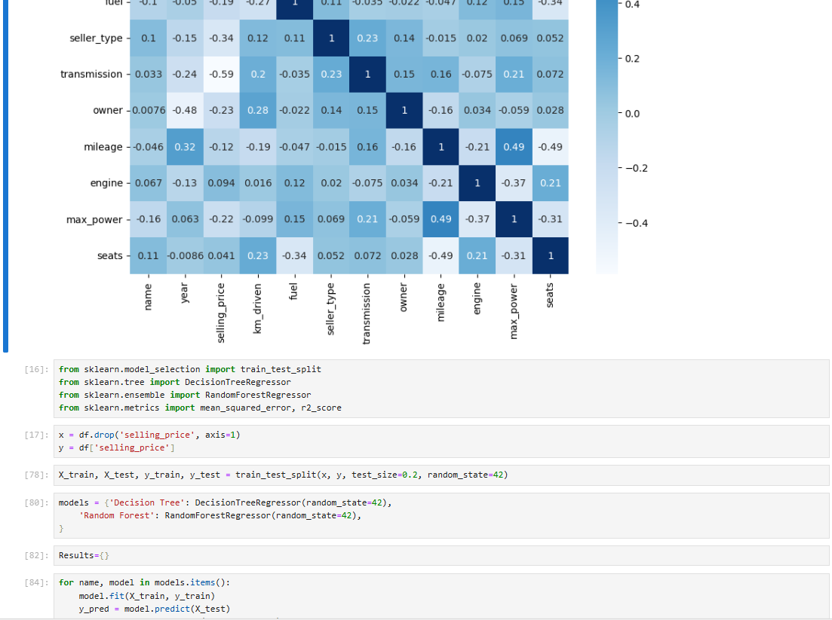

Slide 19
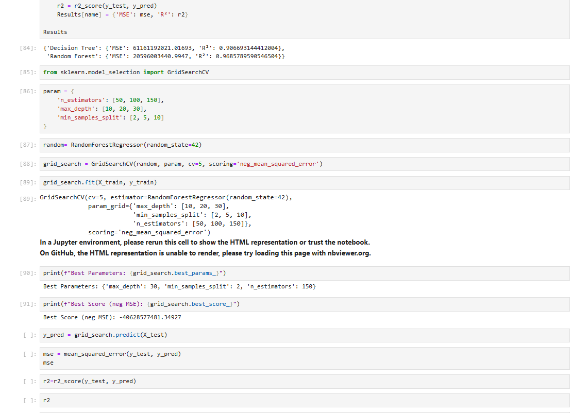

Slide 20


